Slide 1

UE19CS204 – Web Technologies Mini Project
Project Title - INFINITY MOVIES
(A Movie app using Mern Stack )
Section - A
A.R.Manyatha – PES2UG19CS002
Ananya M Gupta - PES2UG19CS039
GITHUB Link –
https://github.com/manyathaar/Web_mini_project.git

Slide 2
Abstract
We have created a movie application called Infinity Movies using MERN technologies.
This is a movie application where the users can enjoy watching movies. The user can search for the movies that are available on the app. An age group of 16 to 60 years can use this application.

Slide 3
There are various genres like action,thriller,
comedy,animation etc available for the user to watch.
The movie page shows the following:
• Movie title
• Movie description
• Duration of the movie
• Rating/Average vote for the movie
• Genre of the movie
• Watch trailer

Slide 4
Features:
Sign In / Sign Up / Sign Out the user.
Receiving a welcoming email when the user signs up the app using Nodemailer.
Watch movies of your choice and trailer is also made available.

Slide 5
Technologies Used
•(include Additional modules/libraries used)
1. Front-end:
React js
HTML
CSS
2.Back-end:
Node js
Express js

Slide 6
3.Database:
Mongodb
Mongoose
Additional libraries used:
Body-parser
cors
Multer
Axios
Nodemailer
Lodash
Bcrypt
Jsonwebtoken

Slide 7
Redux
Redux-thunk
React router
React-script
Reactstrap
Bootstrap

Slide 8
Member Contributions
(Functionality worked on by each team member)
Front-end - Ananya
Back-end and database - Manyatha

Slide 9
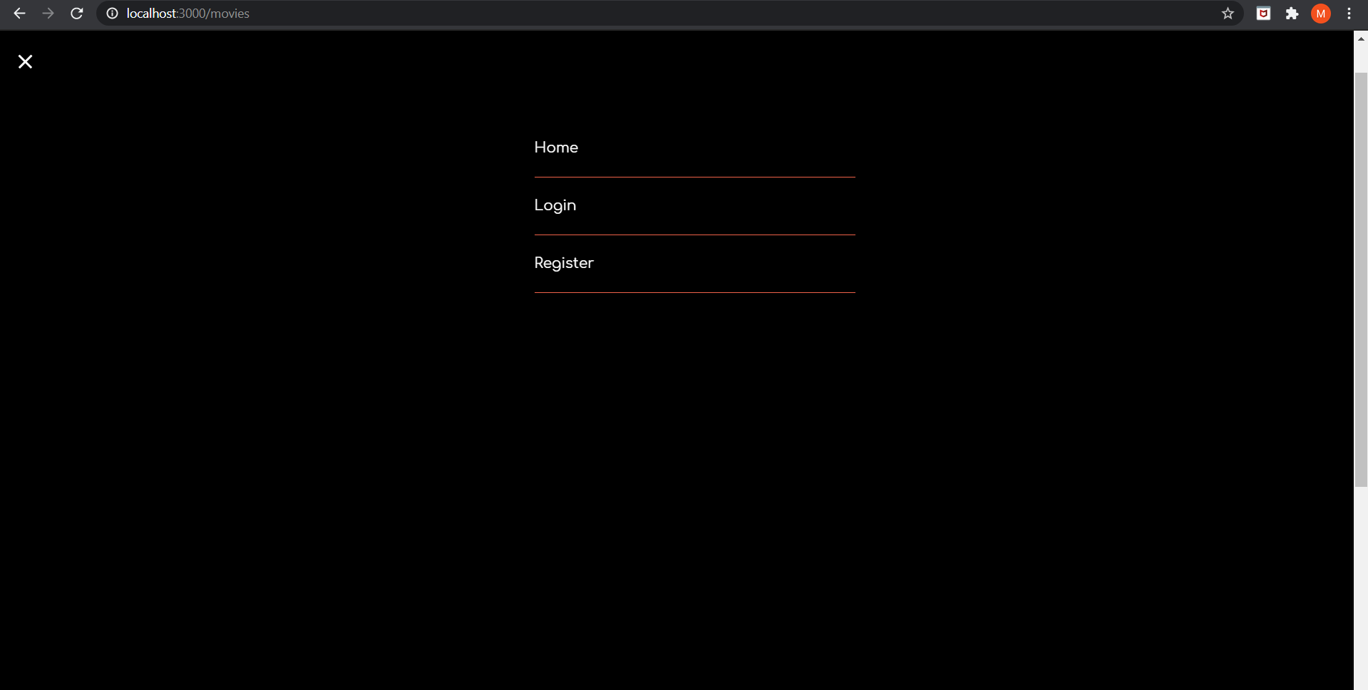
Screenshot of the app

Slide 10
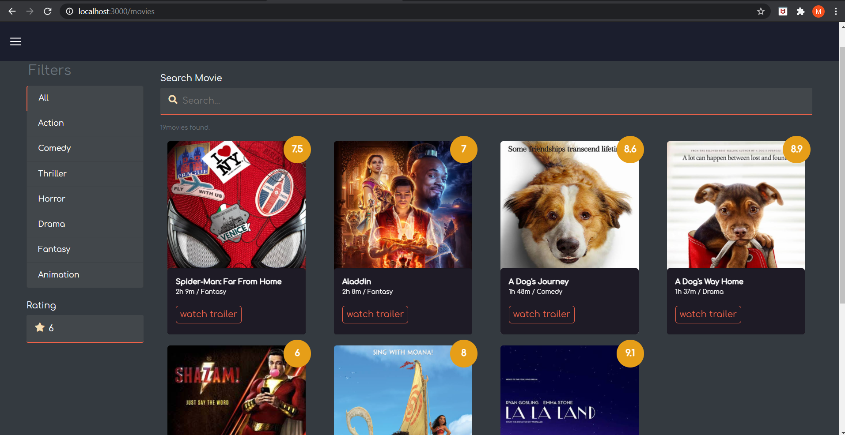
Homepage of the app

Slide 11
